Slide 1
EXPLORATORY DATA ANALYSIS · TASK 1
What drives a
taxi fare?
Eight questions answered from 500,000 NYC taxi trips
Notes:
Title slide. This deck walks through the EDA notebook: the dataset, its quality issues, then the eight questions one by one.

Slide 2
The dataset
500,000
26
5
0
columns
missing values in 9 columns
duplicate rows
trips (rows)
Trips from 2009–2015 with fare, passenger count, pickup/dropoff coordinates, distances to airports, time features, plus Car Condition, Weather and Traffic Condition. The categorical columns are almost perfectly balanced; pickup_datetime still needs converting to a datetime.
Source: task_1_submission.ipynb
Notes:
The data is large and mostly clean at the structural level: negligible missing values, no duplicates, no constant columns.

Slide 3
Data quality issues found
Check | Records | Why it matters
Zero distance | 14,250 | Many still have a non-zero fare
Zero coordinate (GPS default) | 9,893 | Pickup or dropoff recorded at (0, 0)
Zero passengers | 1,796 | Not a valid trip
Distance over 200 km | 1,004 | Up to ~12,000 km — impossible for a taxi ride
Fare over 100 for under 1 km | 93 | Likely entry errors or special charges
Negative fare | 21 | Physically impossible (as low as −44.90)
Zero fare | 14 | Suspicious for a completed trip
Coordinates are stored in radians · median pickup = (40.75°, −73.98°), midtown Manhattan
Notes:
All of these rows are removed before answering the eight questions. Zero distance and zero coordinates are the big ones and overlap heavily.

Slide 4
AFTER CLEANING
96.6%
of trips kept: 482,905 of 500,000
17,095 invalid rows removed. Every answer that follows uses the cleaned data, so data errors no longer distort the results.
Notes:
Only 3.4% of the data was lost. The rules overlap, so the total removed is smaller than the sum of the individual counts on the previous slide.

Slide 5
Eight questions at a glance
Q1
Q2
Q3
Q4
Does passenger count raise the fare?
Does car condition affect the fare?
When are fares highest?
Does traffic affect the fare?
5 AM
No
No
No
Q5
Q6
Q7
Q8
Is distance the strongest predictor?
When are rides most requested?
Does weather change trip distance?
Are airport pickups pricier?
Yes
7 PM
No
Yes
Notes:
The short version: distance drives the fare. Early-morning and airport trips cost more because they are longer. Car condition, traffic, weather and passenger count barely matter.

Slide 6
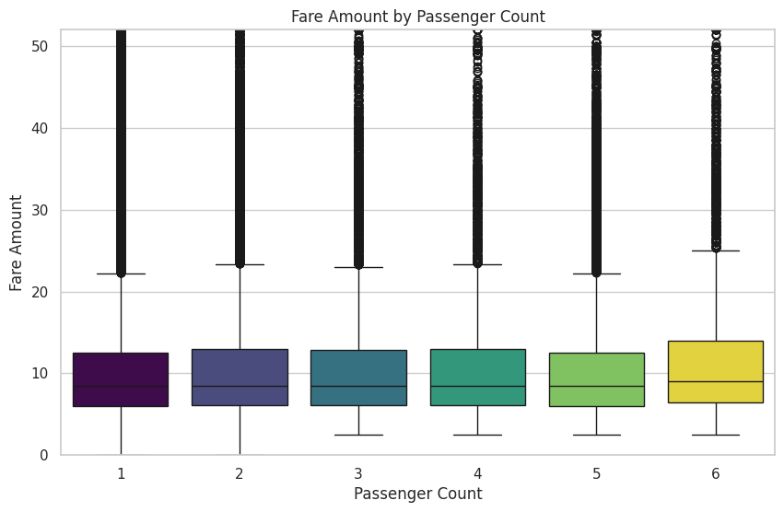
QUESTION 1
Is higher passenger count associated with a higher fare?
Answer
No
Median fare is 8.5 for 1 to 5 passengers and 9.0 for 6. The correlation is just 0.015.
Fares are charged per trip, not per person. The small bump for 6 passengers comes from only ~10k trips.
Box plot · fare by passenger count (cleaned data)
Q1 of 8 · NYC taxi fares EDA
Notes:
Median fare is 8.5 for 1 to 5 passengers and 9.0 for 6. The correlation is just 0.015. Fares are charged per trip, not per person. The small bump for 6 passengers comes from only ~10k trips.

Slide 7
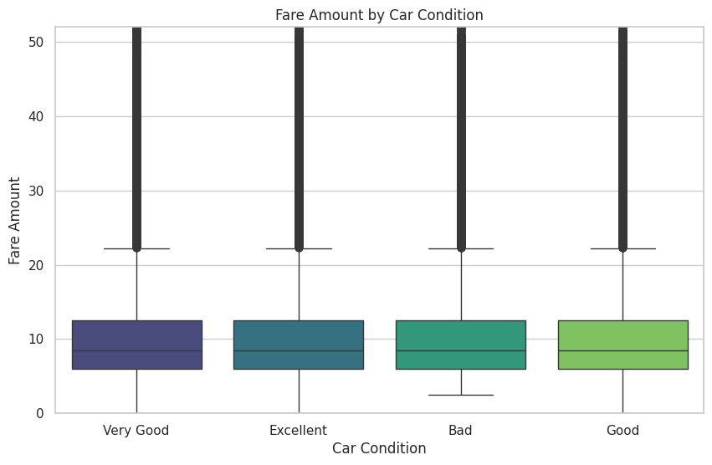
QUESTION 2
Does car condition influence the fare amount?
Answer
No
All four conditions share a median fare of 8.5, and their means differ by under 0.1 (11.30 to 11.39).
About 120k trips per condition. Car condition is not a pricing factor.
Box plot · fare by car condition (cleaned data)
Q2 of 8 · NYC taxi fares EDA
Notes:
All four conditions share a median fare of 8.5, and their means differ by under 0.1 (11.30 to 11.39). About 120k trips per condition. Car condition is not a pricing factor.

Slide 8
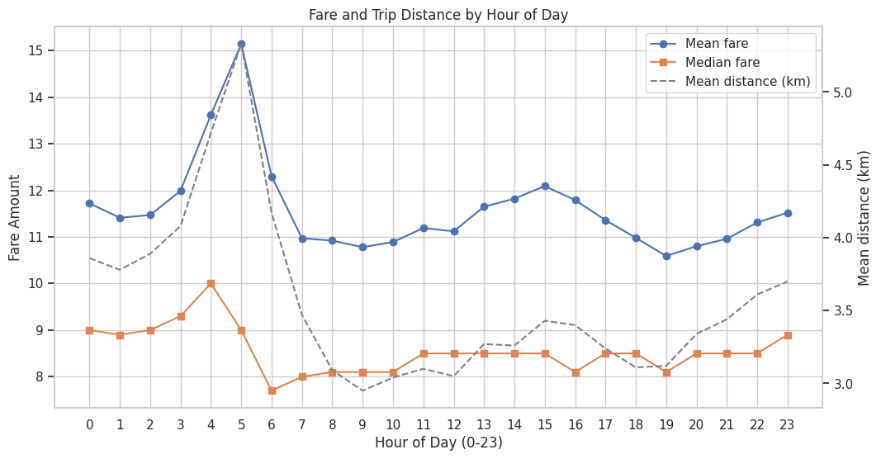
QUESTION 3
At what hour of the day are fares highest?
Answer
5 AM
Mean fare peaks at 15.14 at 5 AM and is lowest at 10.59 at 7 PM.
Why: trips are longest at 5 AM (5.33 km vs ~3 km by day). The median barely rises, so a few long rides drive the peak.
Mean fare, median fare and mean distance by hour
Q3 of 8 · NYC taxi fares EDA
Notes:
Mean fare peaks at 15.14 at 5 AM and is lowest at 10.59 at 7 PM. Why: trips are longest at 5 AM (5.33 km vs ~3 km by day). The median barely rises, so a few long rides drive the peak.

Slide 9
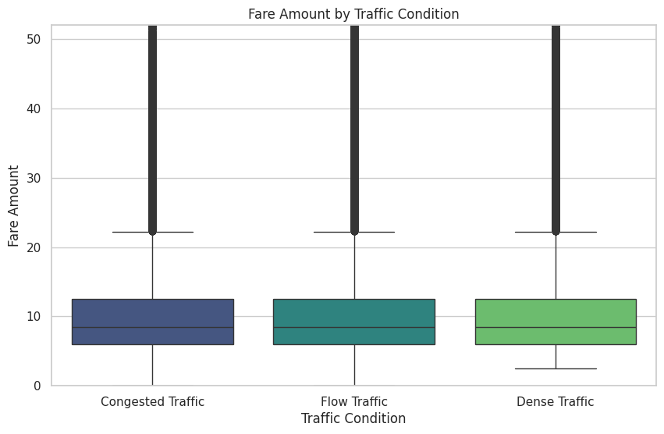
QUESTION 4
Does traffic condition affect the trip fare?
Answer
No
Flow, Dense and Congested Traffic all have a median fare of 8.5; their means differ by only 0.06.
About 161k trips per level. The traffic label does not shift fares.
Box plot · fare by traffic condition (cleaned data)
Q4 of 8 · NYC taxi fares EDA
Notes:
Flow, Dense and Congested Traffic all have a median fare of 8.5; their means differ by only 0.06. About 161k trips per level. The traffic label does not shift fares.

Slide 10
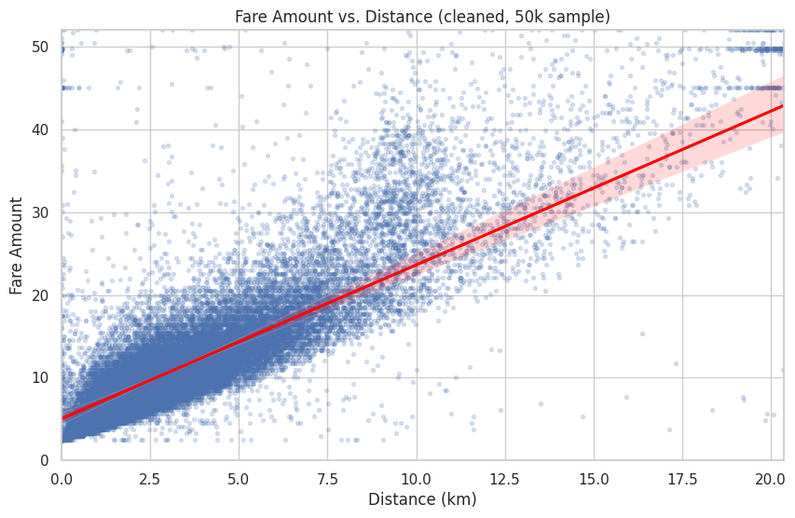
QUESTION 5
Is trip distance the strongest predictor of fare?
Answer
Yes
After cleaning, distance correlates 0.78 (Pearson) and 0.86 (Spearman) with fare, up from 0.61 on raw data.
Next best: distance to JFK (Spearman −0.19) and year (0.15). Every time feature is below 0.03.
Fare vs. distance with regression line (50k sample)
Q5 of 8 · NYC taxi fares EDA
Notes:
After cleaning, distance correlates 0.78 (Pearson) and 0.86 (Spearman) with fare, up from 0.61 on raw data. Next best: distance to JFK (Spearman −0.19) and year (0.15). Every time feature is below 0.03.

Slide 11
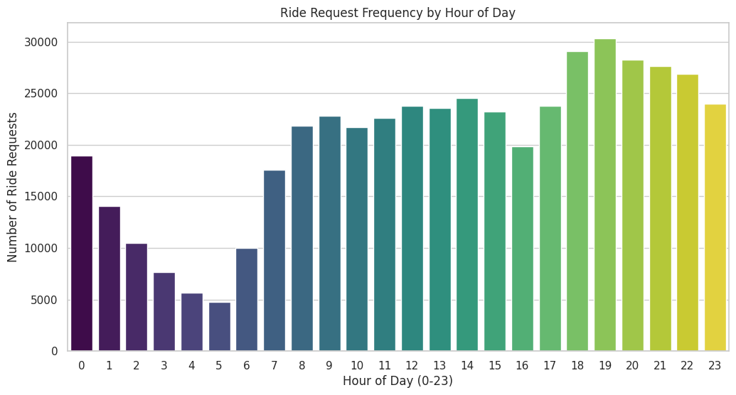
QUESTION 6
At what time of day are ride requests most frequent?
Answer
7 PM
Demand peaks in the evening, at 30,298 trips at 7 PM, and bottoms out at 4,789 at 5 AM.
Note the dip at 4 PM (19,841). The busiest hour has the lowest mean fare; the quietest has the highest.
Count plot · ride requests by hour (cleaned data)
Q6 of 8 · NYC taxi fares EDA
Notes:
Demand peaks in the evening, at 30,298 trips at 7 PM, and bottoms out at 4,789 at 5 AM. Note the dip at 4 PM (19,841). The busiest hour has the lowest mean fare; the quietest has the highest.

Slide 12
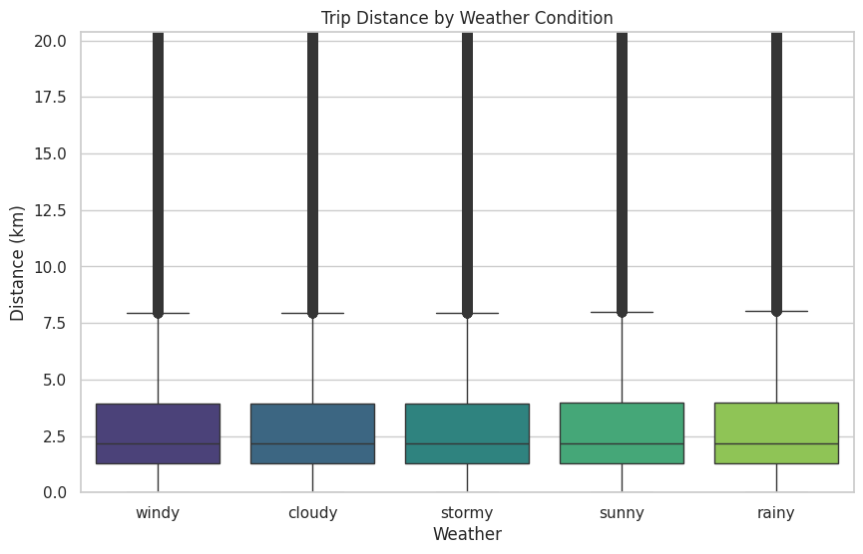
QUESTION 7
Does weather influence the average trip distance?
Answer
No
Median trip distance is 2.16–2.19 km under all five weather conditions.
Means are 3.38–3.40 km, with ~96–97k trips per condition. Weather does not change trip length.
Box plot · distance by weather (cleaned data)
Q7 of 8 · NYC taxi fares EDA
Notes:
Median trip distance is 2.16–2.19 km under all five weather conditions. Means are 3.38–3.40 km, with ~96–97k trips per condition. Weather does not change trip length.

Slide 13
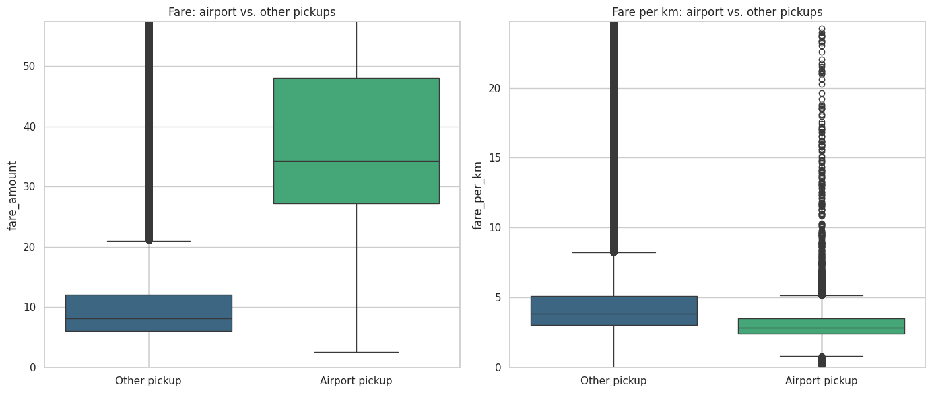
QUESTION 8
Are rides that start closer to airports more expensive?
Answer
Yes
Pickups within 2 km of JFK, LGA or EWR have a median fare of 34.27, versus 8.10 for other trips.
They cost more because they are longer (10.87 km vs 2.11 km). Per km they are cheaper: 2.83 vs 3.86.
Fare and fare per km · airport vs. other pickups
Q8 of 8 · NYC taxi fares EDA
Notes:
Pickups within 2 km of JFK, LGA or EWR have a median fare of 34.27, versus 8.10 for other trips. They cost more because they are longer (10.87 km vs 2.11 km). Per km they are cheaper: 2.83 vs 3.86.

Slide 14
Key takeaways
Distance is the fare
Longer trips cost more
The one strong driver: r = 0.78 (Spearman 0.86) after cleaning.
5 AM and airport pickups have the highest fares because their trips are longest, not pricier per km.
Demand peaks at 7 PM
Labels don’t move price
Evening is busiest; 5 AM is quietest, with a clear dip at 4 PM.
Car condition, traffic, weather and passenger count show no real effect.
Notes:
Wrap-up: after cleaning 3.4% of invalid rows, distance explains most of the fare. Time of day and airport pickups matter through trip length. The categorical labels are flat.

